Slide 1
®

Slide 2
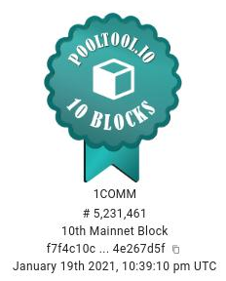
ONE COMMUNITY ADA
ADA Stake Pool on VPS
Ticker: 1COMM
Pledge: 402k
Variable fee: Low 1%!
https://onecommunityada.com
®

Slide 3
ONE COMMUNITY ADA
Ticker: 1COMM
0% margin fees!*
*(Promotionally at least until K=1000, Mar/21)
®

Slide 4
ONE COMMUNITY ADA
Ticker: 1COMM
0% margin fees!*
*(Promotionally at least until Jun/21)
®

Slide 5
ONE COMMUNITY ADA
Ticker: 1COMM
0% margin fees!*
*(Promotionally at least until end of Jun/22)
®

Slide 6
ONE COMMUNITY ADA
Ticker: 1COMM
0% margin fees!*
*(Promotionally at least until end of Aug/21)
Epoch 267 ROA: 7.33%
Lifetime ROA: 5.05%
38 minted blocks up to date!
®

